Slide 1
First oral cholera vaccination campaign in Iraq during an outbreak and humanitarian crisis: Findings from a post-campaign coverage survey, 2015
Steven Russell, MSPH
Eugene Lam, MD, MSPH, MSc
IRMHB-ERRB quarterly meeting
June 29th, 2016
Center for Global Health
Emergency Response and Recovery Branch

Slide 2
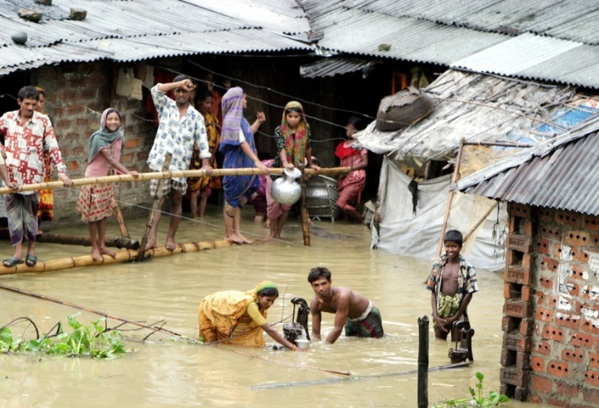
Cholera is caused by poverty, lack of sanitation and clean water
Cholera is a disease characterized by
Severe watery diarrhea
Vomiting
Rapid and severe dehydration
Death without adequate treatment
Cholera is caused by a bacteria called Vibrio cholerae, which is transmitted through the oral-fecal by ingesting contaminated food or water.

Slide 3
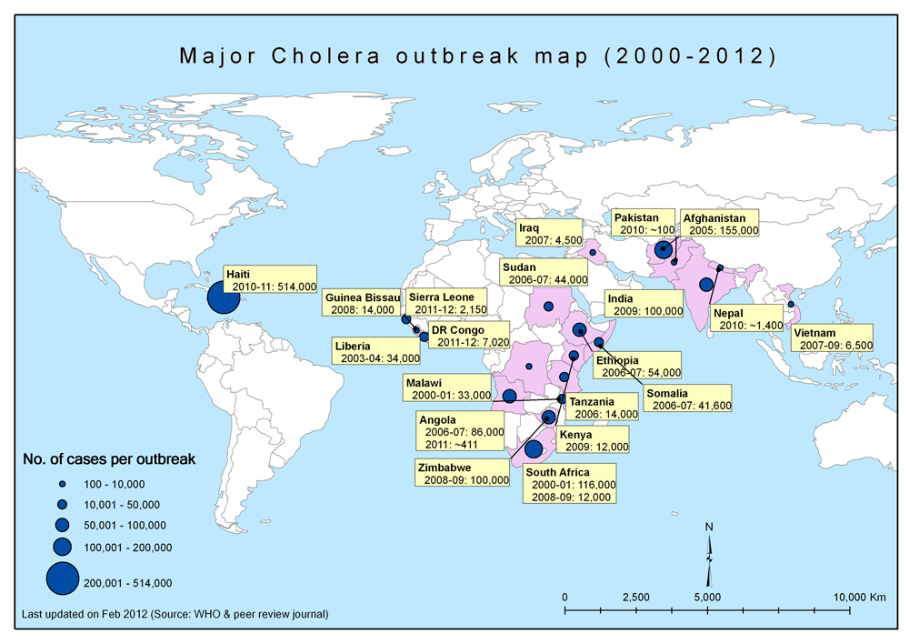
Epidemiology
Expected Global burden
1.4 billion at risk
3 to 5 million cases
120,000 deaths
~50% cases occur in children under 5 yrs
Notes:
Approximately 1.4 billion people are at risk for cholera globally with children under five years of age at disproportionately greater risk
The risk of cholera epidemics among displaced populations during a humanitarian crisis can be elevated, especially in light of massive population movement and overcrowding.
Limited access to clean water, adequate sanitation, and shelter are also risk factors associated with increased risk of cholera epidemics.

Slide 4
Iraq - Background
Up to 3.2 million internally displaced persons (IDPs) throughout the country in 2015
due to increased activity by the Armed Anti-State Group (ASG) and subsequent counter-insurgency operations by the Iraqi government and collision forces
Iraq is also hosting thousands of Syrian refugees due to protracted fighting in Syria between the government and several opposition groups
The risk of communicable disease epidemics is heightened due to the large number of displaced populations
Notes:
The risk of communicable disease epidemics is heightened due to the large number of displaced populations, which often reside in camps or informal settlements or so called collectives centers where there may be inadequate shelter and limited access to safe drinking water, safe food, sanitation facilities, and basic healthcare services. Such risk factors coupled with austerity measures and its impact on health services have contributed to endemic transmission of cholera in Iraq.

Slide 5
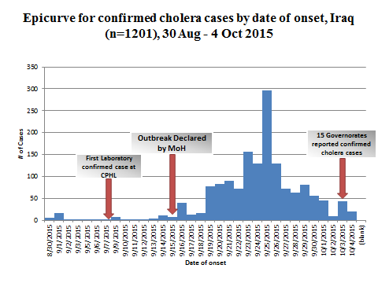
Confirmed cholera cases by date of onset, Iraq, August 30 – October 4, 2015
Notes:
In early Sept of 2015, an initial case of cholera was confirmed in Iraq from the Southern governorate of Diwaniya.
The outbreak continued to rapidly spread throughout the country and by October 2015 there were over 2000 laboratory-confirmed cases of Vibrio cholerae 01 Inaba reported in 15 of the 18 governorates, with the majority of cases reported in Babylon and Baghdad in the South and Central governorates.

Slide 6
Situation Report – Cholera Outbreak (as of October 31st, 2016)
CPHL Confirmed (official) – 2,217 cases
Provincial Confirmed – 3,991 cases

Slide 8
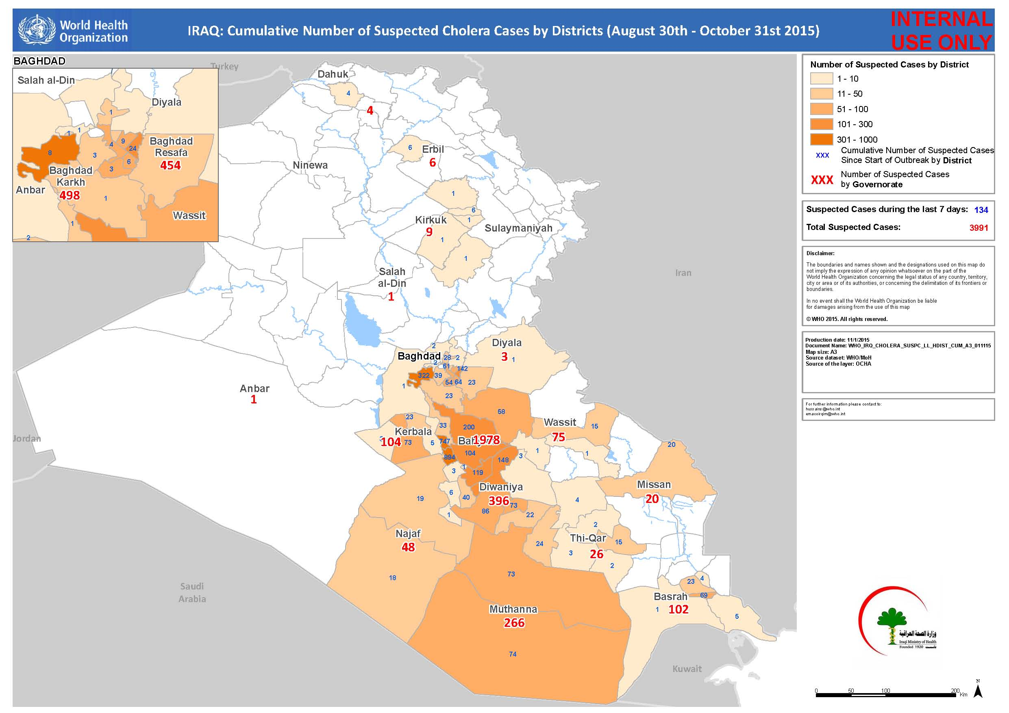
Notes:
Suspected case:
In an area where there is a cholera epidemic, a patient aged 5 years or more develops acute watery diarrhoea, with or without vomiting.
Confirmed case
A suspected case in which Vibrio cholerae O1 or O139 has been isolated from their stool.

Slide 9
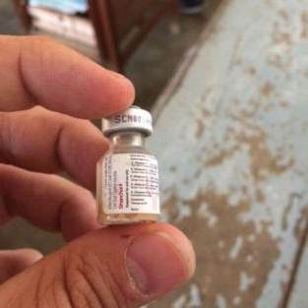
Oral Cholera Vaccine (ShancholTM)
To complement and improve the current cholera prevention and control strategies
Orally administered in 2 doses (2 to 6 weeks apart)
Recommended for ALL individuals ≥1 year
Efficacy
≈ 85% at 6 months
≈ 65% at 5 years
Good heat stability
Killed vaccine, good safety profile
WHO pre-qualification for Shanchol in 2011

Slide 10
Oral Cholera Vaccination Campaign
OCV campaign to complement WASH interventions and other cholera control measures
The two-dose OCV campaign targeted approximately 255,000 persons aged ≥1 year living in selected refugee camps, IDP camps, and collective centers
Deployment of ~510,000 OCV doses used in this campaign
Largest deployment of OCV to date from the Global OCV Stockpile established for outbreak and humanitarian response
1st Round: Oct 31 – Nov 5, 2015
2nd Round: Dec 7 – Dec 9, 2015
Notes:
As part of the 2015 cholera outbreak in Iraq, the Iraqi MoH and implementing partners immediately began planning a vaccination campaign using bivalent oral cholera vaccine (OCV), Shanchol, to complement water, sanitation, and hygiene (WASH) interventions and other cholera control measures.
Due to the large number of IDPs in country and the limited supply of OCV, only IDP camps at full capacity or overcrowded were selected.
The campaign dates were chosen to accommodate a polio vaccination campaign in between the two OCV rounds.
The primary objective of vaccination in an acute humanitarian emergency is to rapidly reduce the risk of disease to protect a population during periods of extreme vulnerability.
Campaign also conducted in the North (fewer cases) to prevent expansion of outbreak into Syria.

Slide 11
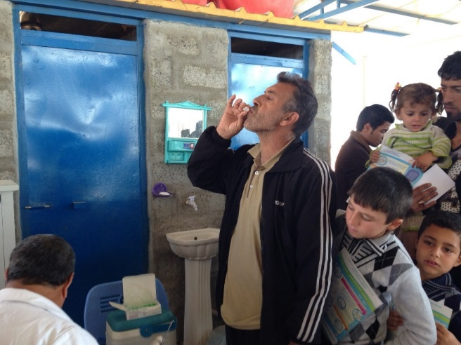
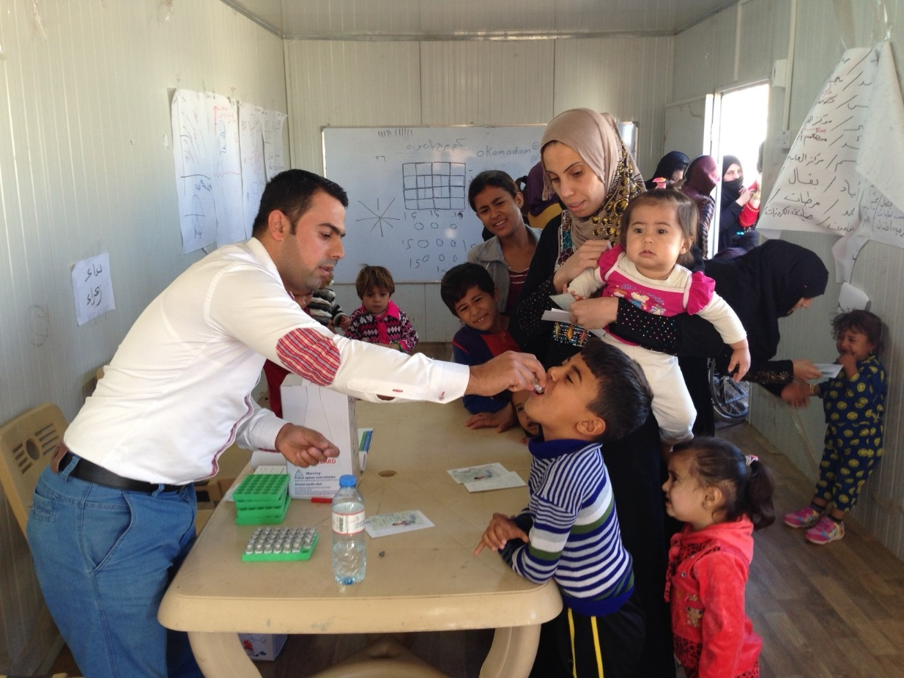
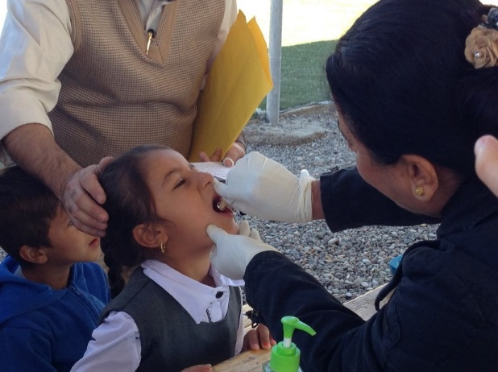
OCV campaign among IDP and refugees in Iraq

Slide 12
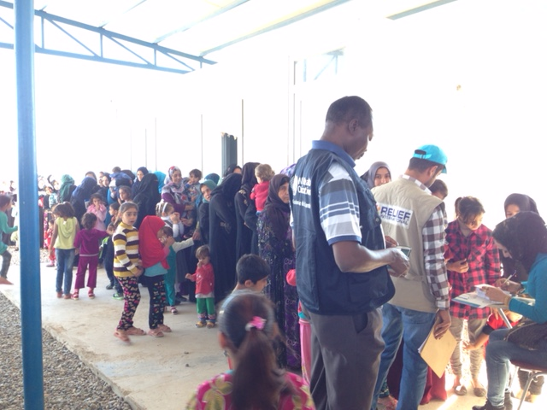
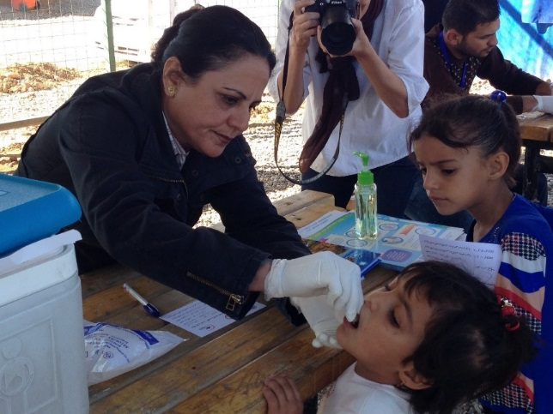
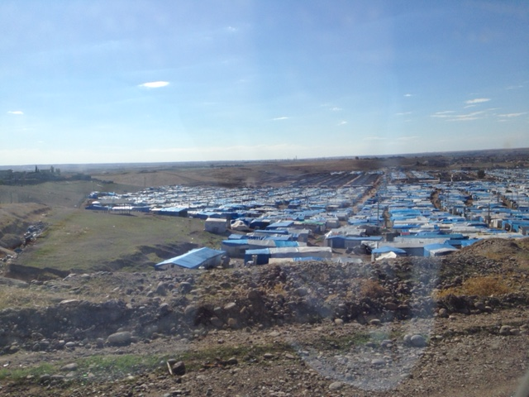
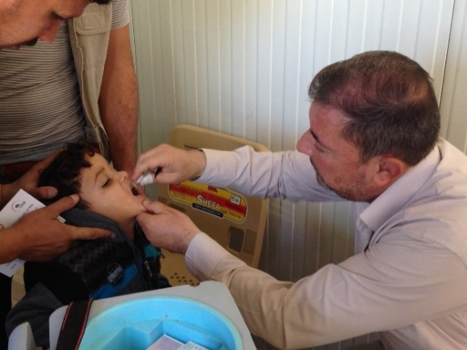
OCV campaign among IDP and refugees in Iraq

Slide 13
Post-Campaign Vaccination Coverage Survey
OCV has never been used in Iraq before
Based on decisions of the MOH, a vaccination coverage survey was conducted immediately after the 2nd round of OCV campaign
Conducted by WHO, CDC, and the Iraqi Red Crescent Society
To evaluate:
vaccine uptake
OCV campaign awareness
barriers to vaccination
any adverse events reported after the campaign

Slide 14
Methods

Slide 15
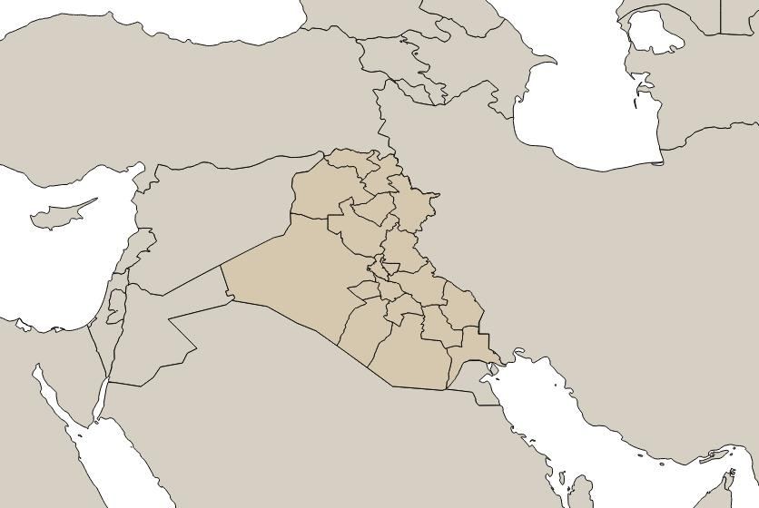
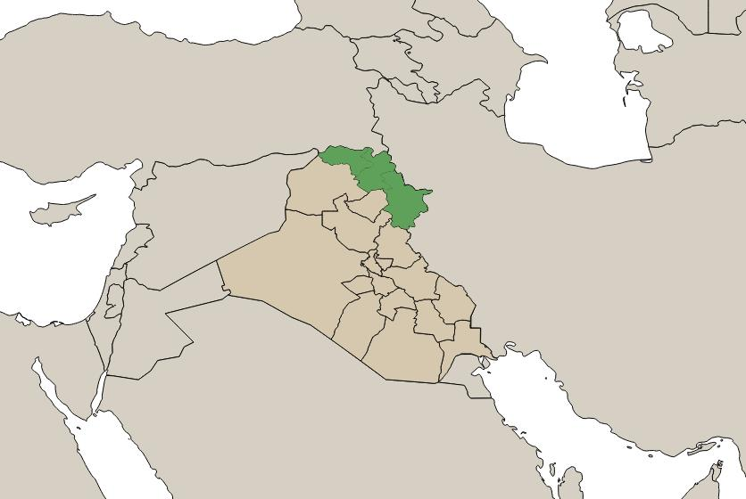
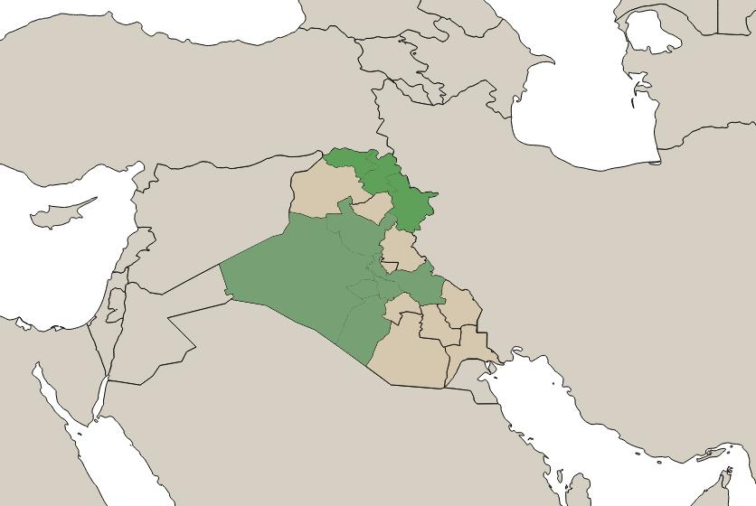


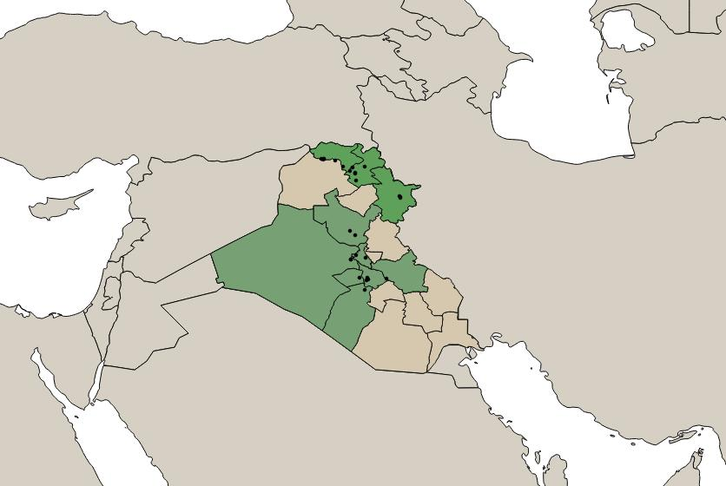

Slide 16
Study Design
We conducted a stratified multi-stage cluster survey
Stratification
1st by governorate
Equally allocated
2nd by camp (within a governorate)
Proportionally allocated based on estimated population size
Clustering
Households within selected camps were clusters
Within each household, all persons in each age group (1-4, 5-14 and ≥15 years) were interviewed
Notes:
For our coverage survey we used a stratified, multi-stage cluster design
In terms of stratification there were 2 stages,
1st we stratified by governorate. We allocated the sample equally to make sure that each governorates would have a precise estimate.
2nd we stratified by camp (within a governorate). And here we allocated proportionally
As far as clustering, we considered a household as a cluster /*because we only selected some households*/ and then we sampled all people in each age group inside of each household.
Then we sampled each person in each age group. These age groups were chosen because they had been used to document the safety of Shanchol vaccine and were used in previous studies.
/*It is clustering because household is a separate stage of selection. There will be a design effect because people within a household are likely to be more similar to each other than to people in the outside community.
You aren’t selecting people randomly from a camp. You are selecting household first so your estimate will have extra variation.*/

Slide 17
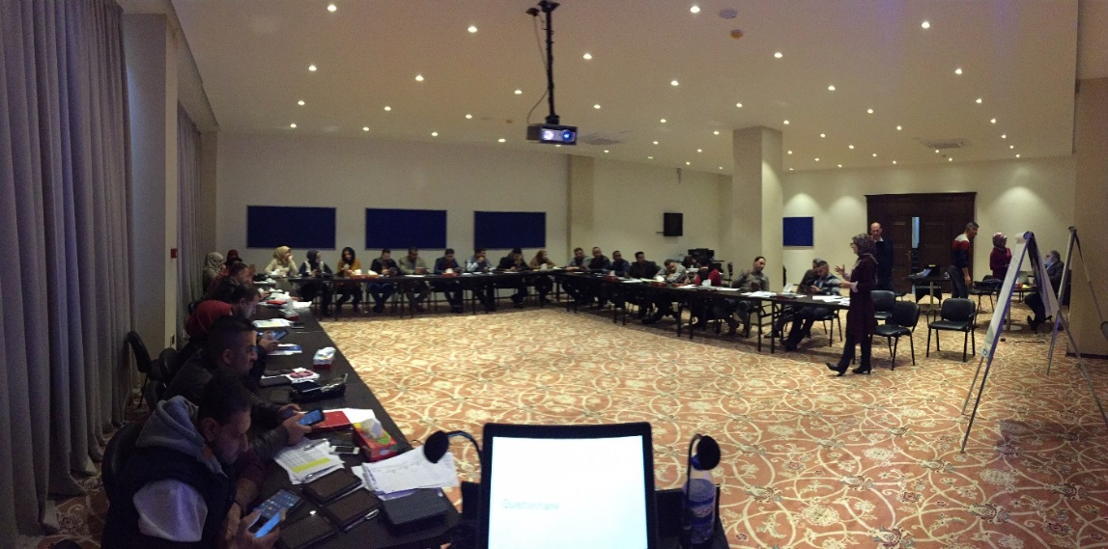
Study Design (cont.)
Camps that had a population of less than 500 persons were excluded for logistical reasons.
Only the 2 largest camps in the governorates of Anbar and Baghdad-Karkh were selected
security and logistical concerns in the South and Central regions.
Notes:
So continuing on with some of the more practical aspects of the study design
we decided to exclude camps that had a population of less than 500 people, because the sample was proportionally allocated, we would have spent many hours just to sample a few people
We didn’t go to call camps in Angbar and Baghdad-Karkh because of safety and logistical concerns
So our results aren’t necessarily representative of these places

Slide 18
Survey Weighting
Used the complex survey procedures in SAS for analysis
Data were weighted based on:
1) Probability of selection
2) Household non-response
3) Individual non-response
Ensured each camp’s weights summed to population of the camp
Notes:
Survey data was then weighted before we used the complex survey procedures in SAS
Data were weighted to account for differences in probability of selection based on the sampling rate within a camp and on non-response
And we ensured that each camp’s weight summed to the population of the camp
Weights are calibrated so that sum of weights in each camp = population of camp
So then each person’s final weight corresponds to the number of people who they represent

Slide 19
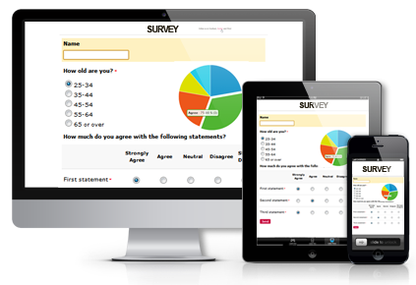
Data Collection
All data were collected using the Survey123 application installed in electronic tablets
Surveyors had experience using the application from previous polio vaccination campaigns in Iraq
Conducted real-time data entry and GPS tracking of survey teams
Allowed CDC and WHO partners to provide remote data quality checks
CDC team gave daily feedback to team supervisors for immediate corrective actions
Notes:
So all of our data was collected using Survey 123, I’m sure some of you are familiar with this application from your own work.
Those in the field conducting the survey had experience with Survey 123 from polio vaccination campaigns so this wasn’t their first time using the tablets.
And what the application allowed us to do was to do real-time data entry and the location of each survey was tracked using GPS.
This was a pretty cool system because we were actually able to provide data quality checks as the survey was being conducted.
There were certain times when the incoming data didn’t seem accurate and in those cases we were able to provide immediate feedback to the survey teams. And hopefully we were able to get some of those issues corrected.

Slide 20
RESULTS

Slide 21
Results
1,226 households and 5,007 individuals participated in the survey
The overall household response rate was 99%.
Response rate for individual governorates ranged from 93% - 100%
Notes:
So after all of the data was collected we ended up with 1226 households and 5007 individuals who had participated in the survey
The overall response rate was very good, with 99% of households reporting.
There ended up being some more practical considerations also. In Babil governorate it turned out that there were
fewer households than expected in 2 collective centers (CC 856 and CC 738) because of relocation of IDPs to another collective center (CC 1010).
We also didn’t get correct reported household data from Anbar governorate and so we had to excluded this governorate from the household level analysis.

Slide 22
Table 2. Individual and household characteristics of participants in oral cholera vaccination coverage survey, Iraq, 2015
Individual:
Characteristics | Frequency | Weighted Percent | 95% CI
Sex
Male | 2487 | 49% | (47%, 51%)
Female | 2500 | 51% | (49%, 53%)
Age (years)
1-4 | 650 | 10% | (9%, 11%)
5-14 | 1235 | 21% | (19%, 24%)
≥15 | 3117 | 69% | (66%, 71%)
Household:
Characteristics | Frequency | Weighted Percent | 95% CI
Number of residents per household | 5007 | median: 4 | IQR: 3-5
Improved primary water source ¹ | 2559 | 79% | (74%, 84%)
Improved secondary water source ¹ | 1573 | 55% | (49%, 61%)
Improved sanitation ² | 4043 | 89% | (84%, 92%)
Had soap for handwashing | 4079 | 88% | (84%, 92%)
¹ Improved water sources include: In house piped water, public piped water, protected well, well with pump, protected spring water, and rain water
¹ Improved sanitation sources include: Flush toilets (connected to system, septic pits, or latrines), ventilated and ameliorated pit latrine, and pit latrine with cement slab
Notes:
Here are some of the individual and household level characteristics of the survey participants. Looking at gender you can see that we had an approximately equal distribution of men and women. You can also see the age breakdown, I think the median age of participants was 23 years old.
Looking at the household level characteristic there were about 4 people per household. We also looked at improved vs unimproved water sources and sanitation facilities. Definitions of improved vs unimproved water sources come from WHO/UNICEF guidelines and they are listed at the bottom of the page. In the survey participants were asked about their water source and then their response was classified as either an improved source or an unimproved source.
There were about 4 people per household.

Slide 23
Table 3. Estimated oral cholera vaccination coverage, Iraq, 2015
 | Total |  |  | Male |  |  | Female
Number of doses | N | Weighted estimate | 95% CI | N | Weighted estimate | 95% CI | N | Weighted estimate | 95% CI
Overall
2 doses | 3523 | 87% | (85%, 89%) | 1735 | 86% | (83%, 89%) | 1777 | 88% | (85%, 90%)
1 dose | 745 | 7% | (6%, 9%) | 363 | 8% | (6%, 11%) | 380 | 7% | (5%, 9%)
Age group
1-4 years
2 doses | 407 | 85% | (81%, 88%) | 213 | 83% | (77%, 88%) | 191 | 85% | (81%, 89%)
1 dose | 89 | 5% | (3%, 7%) | 50 | 6% | (4%, 9%) | 38 | 4% | (2%, 7%)
5-14 years
2 doses | 931 | 89% | (85%, 92%) | 487 | 88% | (83%, 92%) | 442 | 89% | (84%, 93%)
1 dose | 171 | 7% | (5%, 11%) | 88 | 9% | (5%, 14%) | 83 | 6% | (3%, 11%)
≥15 years
2 doses | 2183 | 87% | (84%, 90%) | 1034 | 86% | (83%, 89%) | 1143 | 88% | (84%, 91%)
1 dose | 483 | 8% | (6%, 10%) | 224 | 8% | (6%, 12%) | 258 | 8% | (6%, 10%)
* zero doses and incomplete data not shown in table
Notes:
Here we can see the overall estimated vaccination coverage coverage. The county wide 2 dose coverage is 87% and an additional 7% had 1 dose. So overall 94% of the people had some exposure to the vaccine.
We can also see these numbers broken down by sex, where we see that females had slightly higher coverage than men.
And by age where the 1-4 year old age group had the lowest estimated coverage.

Slide 24
Table 4. Coverage estimates in Northern Governorates
Regions and governorates | Number of doses | Weighted estimate | 95% Confidence Interval
Northern Region (pop=154,396) | 2 | 91% | (87%, 94%)
 | 1 | 6% | (4%, 9%)
Dahuk (pop=98,327) | 2 | 90% | (84%, 94%)
 | 1 | 7% | (4%, 12%)
Erbil (pop=34,675) | 2 | 93% | (90%, 96%)
 | 1 | 4% | (2%, 7%)
Sulaymaniya (pop=21,394) | 2 | 93% | (89%, 96%)
 | 1 | 6% | (4%, 10%)
Notes:
We can also look at coverage by governorate, where we see that 2 dose coverage in the north is at 91%

Slide 25
Table 5. Coverage estimates in South/Central Governorates
Regions and governorates | Number of doses | Weighted estimate | 95% CI
South/Central Region (pop=78,046) | 2 | 80% | (77%, 82%)
 | 1 | 10% | (8%, 12%)
Anbar (pop=41,070) | 2 | 98% | (93%, 99%)
 | 1 | 2% | (1%, 6%)
Wasit (pop=2,300) | 2 | 91% | (85%, 95%)
 | 1 | 6% | (3%, 12%)
Salah Addin (pop=6,000) | 2 | 81% | (74%, 86%)
 | 1 | 16% | (11%, 22%)
Najaf (pop=14,000) | 2 | 74% | (67%, 81%)
 | 1 | 10% | (6%, 16%)
Baghdad Karkh (pop=6,055) | 2 | 37% | (29%, 44%)
 | 1 | 28% | (20%, 36%)
Kerbala (pop=6,017) | 2 | 30% | (22%, 38%)
 | 1 | 35% | (28%, 42%)
Babil (pop=2,604) | 2 | 21% | (15%, 27%)
 | 1 | 31% | (24%, 39%)
Notes:
And in the south where 2 dose coverage is lower at 80%
You can see that some of these governorates, like Anbar and Wasit, had really high coverage while others had very poor coverage.

Slide 26
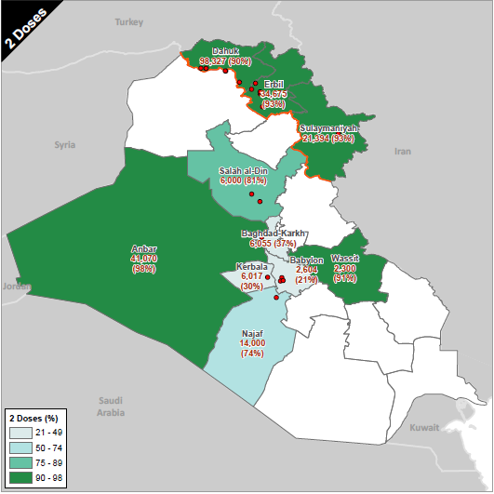
2 dose coverage
Notes:
Here is a visual representation of the overage rates in each governorate. In this chloropleth map you can see that the northern governorates have very good coverage and the coverage in the south and central governorates is a little bit more variable.

Slide 27
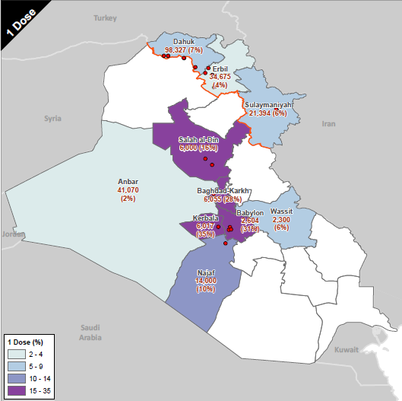
1 dose coverage

Slide 28
Table 6. Estimates of vaccination coverage by type of camp, Iraq 2015
Number of Doses | Collective Centers | Refugee Camp | IDP Camp
2 | 64% | 93% | 91%
1 | 17% | 5% | 8%
0 | 19% | 2% | 1%
Notes:
Interestingly the type of camp was a huge predictor of vaccination status. In collective centers the coverage was very poor in comparison to in refugee camps and IDP camps where the coverage was generally pretty good
Collective centers are informal settlements and are less organized than the camps so this isn’t really surprising, but still an important result and there should be an emphasis on improving coverage in these facilities in the future.

Slide 29
Table 7. Estimates of vaccination coverage by location, Iraq, 2015
Vaccination location | Frequency | Weighted estimate | 95% Confidence Interval
House | 3675 | 90% | (87%, 93%)
Health center | 207 | 6% | (4%, 8%)
School | 110 | 3% | (2%, 5%)
Market | 6 | 1% | (0.2%, 2%)
Other | 9 | <1% | (0.1%, 1%)
Notes:
We can also see vaccination coverage by location. Far and away most people were vaccinated in their homes and a few were also vaccinated in health centers and schools
It’s worth noting that the original strategy of the campaign was to provide the vaccine at fixed post sites around the camps. Somewhere along the way this was changed because the Iraqi MOH preferred home to home visits, since that is what they were comfortable with and had conducted before in previous polio campaigns.

Slide 30
Table 8a. Primary reasons for not receiving oral cholera vaccine (1st Dose)
Reasons for non-vaccination | Frequency | Weighted estimate | 95% CI
Was absent during the campaign | 175 | 35% | (27%, 43%)
Teams did not visit my house | 284 | 30% | (23%, 38%)
Vaccines not available | 99 | 11% | (7%, 18%)
No faith in vaccine | 22 | 4% | (2%, 9%)
Was sick | 24 | 3% | (2%, 5%)
Bad taste of vaccine | 9 | 1% | (1%, 3%)
Decision maker not at home | 5 | 1% | (0.2%, 3%)
Vaccinator was not there | 3 | 1% | (0.2%, 2%)
No response | 3 | 1% | (0.2%, 2%)
Busy / No time | 3 | <1% | (0.1%, 1%)
Did not hear about the vaccination activities | 3 | <1% | (<0.1%, 1%)
Didn’t know when or where to go | 1 | <1% | (<0.1%, 1%)
Religious beliefs | 1 | <0.1% | (<0.1%, 1%)
Other | 74 | 13% | (9%, 17%)
Notes:
Here you can see the primary reasons that were cited by people who were not vaccinated.
The most common was that they said they were not there at the time of the campaign. A good number also said that the teams didn’t visit their homes. And there were also some that said the vaccines were not available.

Slide 31
Table 8b. Primary reasons for not receiving oral cholera vaccine (2nd Dose)
Reasons for non-vaccination | Frequency | Weighted estimate | 95% CI
Was absent during second campaign | 148 | 39% | (28%, 51%)
Teams did not visit my house | 419 | 36% | (26%, 46%)
Vaccines not available | 38 | 2% | (1%, 3%)
No faith in vaccine | 1 | <1% | (<0.1%, 1%)
Was sick | 22 | 9% | (4%, 18%)
Bad taste of vaccine | 4 | 1% | (0.3%, 6%)
Decision maker not at home | 2 | 5% | (2%, 18%)
Vaccinator was not there | 1 | <1% | (<0.1%, 2%)
No response | 1 | <1% | (<0.1%, 1%)
Busy / No time | 5 | 1% | (0.3%, 3%)
Didn’t know when or where to go | 3 | <1% | (0.1%, 2%)
Clinic was closed | 6 | 3% | (1%, 13%)
Bad experience / adverse event after first dose | 12 | 2% | (1%, 7%)
Did not know they needed a second dose | 2 | <1% | (<0.1%, 1%)
Other | 6 | 1% | (0.1%, 2%)
Notes:
And here you see the reasons cited for missing the second dose of the vaccine.
And here you can see a very similar table, the only difference is that this time were are looking at reasons for missing the 2nd dose. So the top 2 responses were the same, again people said they weren’t there during the campaign or the teams didn’t visit. Another reason that was cited here was sickness.

Slide 32
Table 9. Side effects reported within 14 days after receiving the 1st or 2nd dose of cholera vaccine
Symptom | Frequency | Weighted estimate | 95% Confidence Interval
Abdominal pain | 114 | 10% | (8%, 14%)
Fever | 127 | 5% | (4%, 7%)
Vomiting | 52 | 3% | (2%, 5%)
Diarrhea | 89 | 2% | (1%, 4%)
Weakness / Fatigue | 13 | 1% | (0.3%, 2%)
Vertigo | 22 | <1% | (0.2%, 1%)
Headache | 40 | <1% | (0.1%, 0.4%)
Nausea | 20 | <1% | (<0.1%, 1%)
Fainting | 1 | <0.1% | (<0.1%, <0.1%)
Rash | 1 | <0.1% | (<0.1%, <0.1%)
Notes:
So here we can see side effects after receiving the vaccine. In general side effects were not very common.
The most common response was abdominal pain and people also cited fever and vomiting, among other things. Its probably also worth noting that a good number of people reported a bad taste of the vaccine which is not reported here. That’s not a side effect per se but shows that some people had a poor response to the vaccine.

Slide 33
Table 10. Information sources about the oral cholera vaccination campaign
Source | Frequency | Weighted estimate | 95% Confidence Interval
Television | 1046 | 19% | (15%, 24%)
Neighbors/Friends | 599 | 13% | (10%, 16%)
Radio | 315 | 12% | (9%, 17%)
MoH Health Staff / Vaccinators | 579 | 7% | (5%, 10%)
Poster/Banner | 521 | 7% | (5%, 9%)
Schools | 88 | 3% | (2%, 6%)
Community Mobilizer | 62 | 3% | (2%, 6%)
SMS | 57 | 3% | (2%, 5%)
Mosque Announcements | 62 | 1% | (0.3%, 3%)
Internet | 40 | <1% | (<0.1%, 0.2%)
Notes:
Here we have a table showing how people heard about the vaccination campaign. People heard from a variety of sources including television, neighbors, friends, and the radio.
This is something to improve upon. Social mobilization for the campaign was low.

Slide 34
Table 11. Information received among households other than cholera during the OCV campaign
Did you receive any other information on cholera during the campaign in Nov-Dec 2015? | Frequency | Weighted Percent | 95% Confidence Interval
Yes | 2410 | 55% | (49%, 61%)
No | 1743 | 33% | (29%, 37%)
What information did you hear?
Wash hands with soap and water | 2023 | 33% | (28%, 39%)
Cook food thoroughly | 930 | 14% | (11%, 18%)
Wash vegetables/fruits | 1413 | 13% | (10%, 16%)
Boil water | 794 | 15% | (12%, 18%)
Clean cooking utensils/vessels | 635 | 6% | (4%, 8%)
Dispose of human waste properly | 519 | 5% | (4%, 7%)
Drink or use water treated with chlorine products | 334 | 4% | (3%, 7%)
Go to health center if I have cholera | 312 | 4% | (3%, 6%)
Take ORS if I have cholera | 163 | 3% | (1%, 6%)
Don’t know/don’t remember | 35 | <1% | (0.1%, 0.4%)
Other, specify | 5 | <1% | (<0.1%, 0.1%)
Notes:
So here we have a table showing information received by households during the campaign. This is additional health messaging that was given while the surveyors were visiting the houses. You can see that only 55% of people said they had received this messaging. So this is definitely something that can be improved on in the future.
Most commonly people were told to wash their hands. Some were also told to cook their food thoroughly, to wash their fruits and vegetables and to boil water. And so again this is something that ideally would be approved upon in the future.

Slide 35
DISCUSSION

Slide 36
Conclusions
The post-campaign OCV coverage survey conducted in Iraq reported an overall estimated 87% two-dose coverage
Higher coverage in the Northern governorates compared to the South and Central governorates due to increased insecurity
Due to civil strife, heavy rains, and challenges in program management
Despite challenges in implementation during a humanitarian crisis, the two-dose coverage in Iraq was high
Notes:
Coverage surveys permit the evaluation of vaccination services and assessment of vaccination strategies
The use of electronic tablets for monitoring and data submission enabled remote review of data quality and immediate feedback for corrective actions

Slide 37
Unique Strategies in Iraq
Iraqi MOH adopted a primarily door-to-door strategy
Used for previous polio and measles campaigns
Strategies to provide vaccination at entrance to camps and extended hours of vaccination into the evening
Captured adult males who worked outside camps during the day
Use of polio eradication assets and activities to support public health emergencies
Notes:
Door-to-door strategy
This explains the finding that the vast majority of respondents (90%) were vaccinated at their residential structure compared to the 6% at health facilities. A small proportion of respondents (3%) received vaccination at school (primarily among those aged 5-14 years).
The most common reasons for not receiving OCV were 1) being absent during the campaign and 2)Teams not visiting their homes
In addition, 2% of adult males aged 15 years and older were vaccinated at the market where they were likely working during the day. Strategies to provide vaccination at entrance to camps and extended hours of vaccination into the evening helped capture adult males who worked outside the camps in nearby markets during the day.
In addition, its success in campaign implementation was in part due to the use of polio eradication assets and activities to support public health emergencies.
Experience of optimizing polio eradication assets, infra-structure, and experience, in this survey has been unique and proves principle of the legacy of polio eradication efforts in action

Slide 38
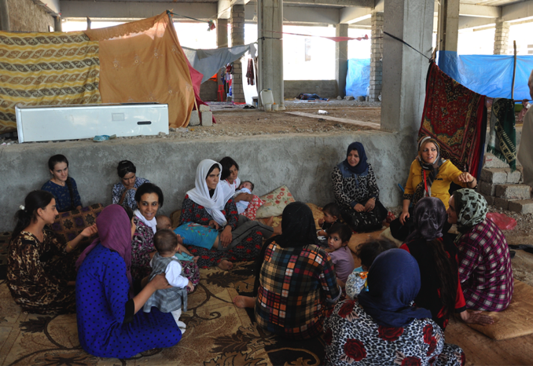
Social Mobilization
Notes:
The most common source of information of the OCV campaign was television, neighbors/friends, and the radio.
Less than 10% reported receiving campaign information from Ministry of Health staff and community mobilizers.
Advanced communication to health clinics and NGOs for social mobilization can result in greater use of community mobilizers and health workers to increase vaccine update in future campaigns.
About half of all survey participants reported receiving educational information on cholera other than OCV (i.e. WASH interventions) during the campaign.
Improved planning of social mobilization can also integrate WASH interventions into campaign communication strategies, both of which are important for the prevention and control of cholera.

Slide 39
Limitations
Variation in the training of enumerators by supervisors
Limited access/monitoring on the ground due to insecurity
Survey results should only represent the selected camps and collective centers surveyed
Notes:
Limitations in this survey included variation in the training of enumerators by supervisors.
Enumerators were not able to travel to Erbil for training by CDC and WHO staff and therefore relied on training by supervisors which may have varied by governorate.
There were also limitations in access and monitoring on the ground due to insecurity.
The survey results should only represent the selected camps and collective centers surveyed.
We were not being able to visit smaller camps in Southern and Central governorates due to areas of heaviest conflict and therefore the assessment is not be representative of these areas.

Slide 40
OCV Global Stockpile
Overall limited number of vaccines in the Global OCV Stockpile
Many non-camp IDPs were not targeted in this campaign
Ongoing efforts to increase the number of stockpile vaccines
WHO recently approved a third manufacturer of OCV to double global supply to 6 million doses for 2016
Notes:
Due to the overall limited number of vaccines in the Global OCV Stockpile, refugees and selected IDP camps were prioritized to receive the vaccine during this humanitarian crisis
Many non-camp IDPs were not targeted in this campaign due to limited supply of vaccine available at the global level
Efforts to increase the number of stockpile vaccines available for emergency response and humanitarian emergencies are ongoing
WHO recently approved a third manufacturer of OCV to double global supply to 6 million doses for 2016 helping to address global shortages and expand access in more countries in need

Slide 41
Summary
First mass OCV campaign conducted in Iraq
OCV campaigns can be part of a comprehensive response to cholera outbreaks among high-risk populations in conflict settings
Complementary public health intervention of cholera control programs
Use of electronic tablets in coverage survey enabled remote data quality checks and daily feedback to team supervisors
Notes:
Vaccination is one of the most basic and critical health interventions for protecting vulnerable populations during emergencies. This was the first mass OCV campaign conducted in Iraq. Results from the survey indicated a high proportion of the target population being vaccinated against cholera with OCV and provided MOH key lessons learned to guide future OCV campaigns.
The Iraq experience has also shown that OCV campaigns can be part of a comprehensive response to cholera outbreaks among high-risk populations in conflict settings in addition to provision of safe water, adequate sanitation, and hygiene practices.
The use of OCV in humanitarian emergencies can complement the foundational public health interventions of all cholera control programs that includes, appropriate case management, enhanced environmental control, improved hygiene and sanitation, and social mobilization.
The use of electronic tablets in this coverage survey enabled remote data quality checks and daily feedback to team supervisors for immediate corrective actions in areas with poor accessibility and security concerns.

Slide 42
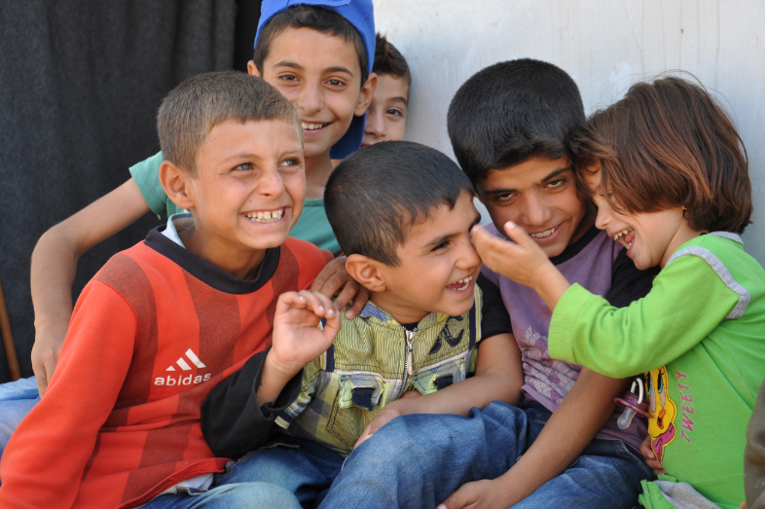
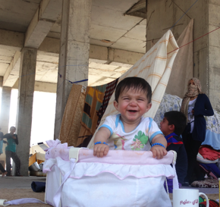
Thank you
For more information please contact Centers for Disease Control and Prevention
1600 Clifton Road NE, Atlanta, GA 30333
Telephone: 1-800-CDC-INFO (232-4636)/TTY: 1-888-232-6348
Visit: www.cdc.gov | Contact CDC at: 1-800-CDC-INFO or www.cdc.gov/info
The findings and conclusions in this report are those of the authors and do not necessarily represent the official position of the Centers for Disease Control and Prevention.
Center for Global Health
Emergency Response and Recovery Branch

Slide 43
Backup Slides

Slide 44
Health Sector Response
Oral Cholera Vaccines: International Coordinating Group (ICG) approved 510,000 doses of cholera for 255,000 IDPs and refugees residing in formal camps.
Cholera Treatment centres: one cholera treatment centre revitalized in each tertiary hospitals per governorate
Essential Medicine supply: Fifteen (15) International Diarrheal Diseases Kits (IDDKs) shipped to MoH , enough to treat 7500 cholera cases and additional 12 IDDKs in pipeline
Funds allocations: for strengthening the case management, active surveillance and revitalization of ORTs with a strong M&E component in the thirteen most affected governorates.
Surge Deployment: Surge teams deployed from HQ/Geneva & EMRO, CDC-Atlanta and ICCRD,B

Slide 45
WASH Sector Response (1)
Advocacy at highest government level to ensure provision of adequate quantity of chlorine, Aluminium Sulphate in country
Till date supplies provided:
one million Aqua tablets,
385 tons of chlorine gas
200 tons of Aluminium sulphate
Advocacy in process to facilitate transport of 1,500 tons of chlorine gas from Jordan, through KSA and Kuwait.
1000 water tanks, 50,000 jerry cans and 1,000 basic family water kits and 200,000 water bottles distributed

Slide 46
WASH Sector Response (2)
Hygiene Promotion:
C4D – country wide coverage established.
One million Key WASH and Health messages pamphlets and FAQs published with nationwide disseminated.
Messages being disseminated through electronic media and mobile networks.
Twenty mobile vans have dedicated to awareness events
3. Sanitation:
Disinfection of septic tanks of health facilities in outbreak areas through desludging trucks and disposing of waste in authorized landfills in West Baghdad and Najaf by Governorate Directorate of Water (GDW), in coordination with UNICEF, MSF-Spain

Slide 47
Table 14. Overall estimate of oral cholera vaccination coverage by vaccination card status, Iraq, 2015
Number of doses | 2 Card (n=1498) | 1 card (n=724) | Recall (n=2765) | Total
2 (n=3523) | 47% | 27% | 13% | 87%
1 (n=745) |  | 5% | 3% | 8%
0 (n=739) |  |  | 4% | 4%
 | 47% | 32% | 20% | 99%
*1% don't remember / incomplete
Notes:
Among those who reported receiving two OCV doses, only 47% had both doses recorded on their vaccination cards while 27% had only one dose recorded and 13% had no documentation available.
This finding suggests a need for reminding vaccine recipients to bring back vaccination cards for the second round and also improvement in training of vaccination card recording for survey teams.

Slide 48
Table 15. Did you (or child) spit part of the first or second dose of the vaccine due to bad taste?
Response | Frequency | Weighted estimate | 95% Confidence Interval
Yes | 509 | 25% | (22%, 28%)
No | 3694 | 72% | (69%, 75%)
Don't know | 41 | 1% | (0.4%, 1%)
Missing | 30 | 2% | (1%, 4%)

Slide 49
Table 16. Availability of soap and hygiene practices reported among households during the OCV campaign
Soap for handwashing | Frequency | Weighted estimate | 95% Confidence Interval
Yes | 4079 | 88% | (84%, 92%)
No | 338 | 4% | (2%, 7%)
If yes, when do you wash your hands with soap?
After using the toilet | 3798 | 86% | (81%, 90%)
Before eating | 2838 | 52% | (47%, 58%)
After eating | 2659 | 48% | (43%, 52%)
Before cooking | 1359 | 34% | (29%, 40%)
After washing/cleaning tables | 1096 | 20% | (16%, 23%)
After cleaning baby diapers/baby stools | 1018 | 13% | (10%, 16%)
After cleaning the home | 749 | 9% | (7%, 13%)
Other | 8 | 1% | (0.2%, 4%)

Slide 50
Table 12. Specific primary and secondary water sources reported by households during the OCV campaign
Primary water source | Frequency | Weighted estimate | 95% Confidence Interval
Piped water, in house | 1734 | 71% | (66%, 76%)
Piped water, public | 825 | 14% | (11%, 17%)
Water truck/water vendor | 1185 | 11% | (9%, 14%)
Bottled water | 651 | 4% | (3%, 5%)
River/stream/lake/irrigation canal | 10 | <0.1% | (<0.1%, 0.3%)
Well, unprotected | 10 | <0.1% | (<0.1%, 0.2%)
Spring water, unprotected | 5 | <0.1% | (<0.1%, 0.2%)
Secondary water source | Frequency | Weighted estimate | 95% Confidence Interval
Piped water, in house | 737 | 34% | (29%, 39%)
Water truck/ water vendor | 923 | 26% | (20%, 31%)
Piped water, public | 779 | 15% | (14%, 17%)
Bottled water | 1591 | 12% | (10%, 16%)
Well, protected | 57 | 9% | (7%, 14%)
Well, unprotected | 175 | 2% | (1%, 4%)
Second source not available | 105 | 1% | (0.4%, 1%)
Other | 38 | 1% | (0.3%, 1%)
Spring water, unprotected | 9 | <1% | (<0.1%, 0.2%)

Slide 51
Table 13. Specific sources of sanitation reported among households during the OCV campaign
Sources of sanitation | Frequency | Weighted estimate | 95% Confidence Interval
Pit latrine with cement slab | 1531 | 56% | (50%, 62%)
Flush, connected to system | 941 | 26% | (21%, 31%)
Flush, connected to septic pits | 1226 | 11% | (9%, 13%)
Pit latrine, without cement slab | 151 | 4% | (2%, 6%)
Flush, connected to latrines | 310 | 2% | (1%, 2%)
Bucket toilet | 210 | 1% | (1%, 2%)
Pit latrine, ventilated and ameliorated | 15 | 1% | (0.2%, 2%)
Hanging toilet/Hanging latrine | 35 | <1% | (<0.1%, 0.2%)
Other | 4 | <1% | (<0.1%, 0.2%)

Slide 52
Table 17. Improved vs unimproved primary and secondary water sources reported among households during the OCV campaign
Source | Frequency | Weighted estimate | 95% Confidence Interval
Primary Water Source
Improved ¹ | 2559 | 79% | (74%, 84%)
Unimproved ² | 1861 | 14% | (12%, 17%)
Missing | 48 | 7% | (4%, 11%)
Secondary Water Source
Improved ¹ | 1573 | 55% | (49%, 61%)
Unimproved ² | 2744 | 38% | (32%, 44%)
Second source not available | 105 | 1% | (0.4%, 1%)
Missing | 46 | 7% | (4%, 11%)
¹ Improved water sources include: In house piped water, public piped water, protected well, well with pump, protected spring water, and rain water
² Unimproved water sources include: unprotected well, unprotected spring water, river/stream/lake/irrigation canal, bottled water, and water truck/water vendor

Slide 53
Table 18. Improved vs. unimproved sources of sanitation reported among households during the OCV campaign
Sources of sanitation | Frequency | Weighted estimate | 95% Confidence Interval
Improved ¹ | 4023 | 89% | (84%, 92%)
Unimproved ² | 400 | 5% | (3%, 7%)
Missing | 45 | 7% | (4%, 11%)
¹ Improved sanitation sources include: Flush toilets (connected to system, septic pits, or latrines), ventilated and ameliorated pit latrine, and pit latrine with cement slab
² Unimproved sanitation sources include: Pit latrine without cement slab, bucket toilet, hanging toilet/hanging latrine, canal or open defecation/bush/field

Slide 54
Table 19. Type of Camp
Governorate | Sites | (Refugee or IDP or CC)
Dahuk | Bajet Kandala | IDP
 | Esyan | IDP
 | Bardarash | IDP
 | Khanke | IDP
 | Domiz Camp 1 | Refugee
 | Domiz Camp 2 | Refugee
Erbil | Harshm | IDP
 | Darashakran Camp | Refugee
 | Kawergosk Camp | Refugee
 | Qushtapa Camp | Refugee
 | Baharka | IDP
 | Basirma Camp | Refugee
Sulaymaniya | Arbat IDP | IDP
 | Arbat 2 (Ashti) | IDP
 | Arbat Camp | Refugee
Najaf | Ba Husein Road | CC
Baghdad Kardh | Alahal Camp | Refugee
 | Takiya kasnazaniya | CC
Kerbala | Displaced population CC | CC
Salah Addin | Alhwaish | CC
 | Alishagee | CC
Anbar | Amiria carvans camp | Refugee
 | Alamiria tourist camp | Refugee
Wasit | Numania Shoamali Street CC | CC
Babil | Collective center – population 856 | CC
 | Collective center – population 738 | CC
 | Collective center – population 1010 | CC

Slide 56
Sample Size Calculations
Assumptions for sample size calculation
2-dose coverage of 75%
Intraclass correlation of 0.2
Average household size of 6
Non-response rate of 5%
Design effect of 2
Wanted to achieve precise estimates for:
Each individual governorate
1-4 year old age group in the northern and south/central regions
We decided to sample 120 households per governorate
4.7% precision for each governorate
8.0% precision in 1-4 age group in each region
Notes:
Before starting the study we conducted some sample size calculations
And we came up with the assumptions
And so some of the goals we had in mind when calculating the necessary sample size were that we wanted to be able to have precise estimates for each individual governorate and we also wanted to have a good estimate for the 1-4 age group in each region.
And so based on these goals we decided that we should sample 120 household in each governorate which would give us a precision of 4.7% for each individual governorate and would also give us that 8% precision we wanted for the 1-4 year age group

Slide 57
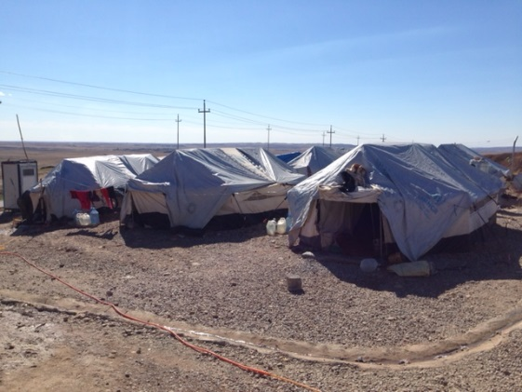
Structure of Study Area
{
Overall
Country
{
Region
North
South/Central
Governorate
Dahuk
Erbil
Sulaymaniyah
Anbar
Babylon
Baghdad-Karkh
Kerbala
Najaf
Salahal-Din
Wassit
Bajet Kandala
Baharka
Arbat 2
Alamiria Tourist
CC 1010
Alahal
Displaced Population
Ya Husein
Alhwaish
Numania
Bardarash
Basirma
Arbat
Amiria Carvans
CC 738
Takiya
Eshaqi
Camp
CC 856
Domiz Camp 1
Darashkran
Arbat IDP
Domiz Camp 2
Harshm
Esyan
Kawergosk
Qushtapa
Notes:
So before we jump into the methods sections, I wanted to familiarize you with how the study area was organized
So the overall study area was the country of Iraq
Next we classified the country based on two regions, one composed of northern governorates, and another composed of southern and central governorates
Within each region there are then governorates, so 3 governorates in the north and 10 governorates in the south.
Then within governorates we have a camps which is our smallest sampling area

Slide 58
Survey Questions
Each interview consisted of individual and household level questions.
Individual level questions included:
demographic information
vaccination status
reasons for non-vaccination
adverse events following immunization (AEFI).
Household level questions were related to campaign awareness as well as water, sanitation, and hygiene (WASH) interventions.
Improved/unimproved primary water source
Improved/unimproved secondary water source
Improved/unimproved sanitation
Number of people who shared a toilet
Soap for handwashing
Notes:
For household level questions we looked at WASH indicators. In any cholera intervention of course it is very important to address the WASH component as well. So collected data on water sources and sanitation related conditions within the camp..

Slide 59
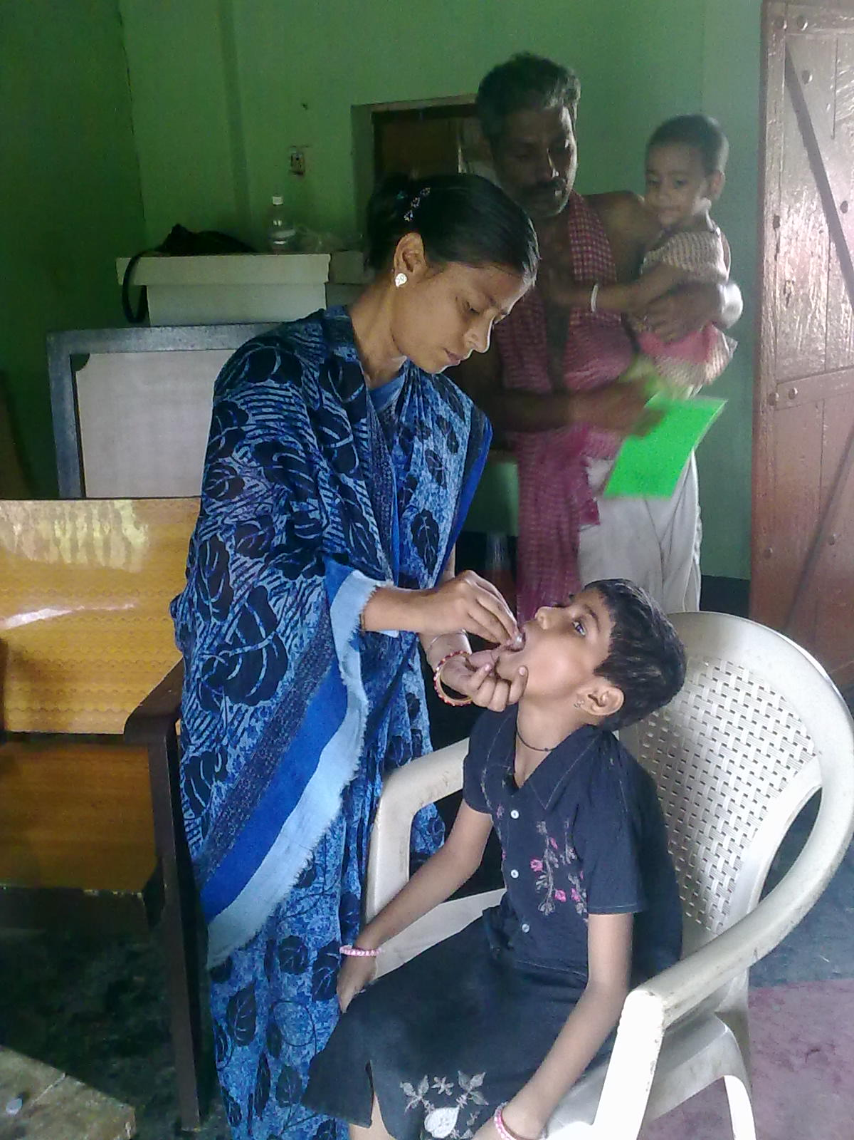
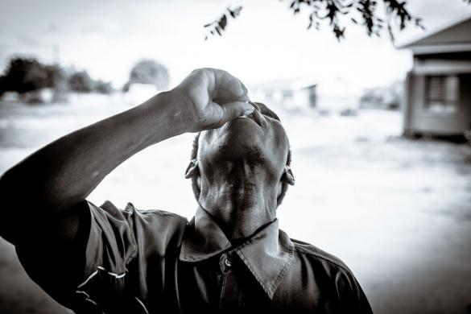
Vaccine Instructions
Dosage and Administration
ShancholTM cholera vaccine must be administered orally; it should never be given parentally.
It is packed in a glass bottle of 1.5ml.
The vaccine is given in two doses spaced between 2 to 6 weeks
No re-dosing for individuals who spit out

Slide 60
Outbreak Response
Cholera Command and Control Centre (C4) established
MOH leading the response with the technical support of WHO (co-chair of the Task Force).
Cholera Response Plan strategies include:
Case management;
Active/Passive Surveillance;
Laboratory strengthening;
Health and Hygiene Promotion;
Water, Sanitation and Hygiene;
Coordination;
Vaccination and
Logistics
Notes:
In 2011, because of worldwide increases in cholera incidence, the World Health Assembly adopted Resolution 64.15, which calls for implementation of an integrated and comprehensive approach to cholera control
includes rapid provision of safe water, adequate case management at health facilities, and strengthened case detection through early warning surveillance and laboratory confirmation.
In addition, preventive measures including use of OCV is included in this comprehensive approach

Slide 61


Sampling
1) The sampling interval was calculated based on the estimated number of households in a camp and the desired sample size
A random start was selected
Between the 1st household at the corner of the camp and the $n^{th}$ household (based on sampling interval)
3) Households were systematically sampled using the sampling interval
4) In camps where the population size was larger than estimated, the survey team continued to sample households using the pre-prescribed sampling interval
Sampling interval
Random start
Notes:
In order to carry out our sampling in each individual camp, the first thing we did was create a predetermined sampling interval, which was calculated by dividing the number of household in a camp by the number of households we planned on sampling according to our study design.
Once we had calculated our sampling interval, the next thing we did was chose a random start. That starting place was selected by randomly choosing a household between the 1st household and the nth household starting from the corner of a camp. So for example if our sampling interval was 3, we randomly chose one of the first 3 listed households.
Next, we systematically worked through the camp and selected every nth household based on the sampling interval. So again in this example we sampled every third household.
In some cases, the we may have underestimated the number of household in a camp. I that case, we would have reached our desired sample size before reaching the end of the camp. And so when that happened we continued with our pre-determined sampling interval to reduce potential bias.

Slide 62
Table 1. Household response rate by governorate for oral cholera vaccination coverage survey, Iraq, 2015
Governorate | Responded | Contacted | Governorate response rate
Dahuk | 113 | 122 | 93%
Erbil | 122 | 123 | 99%
Sulaymaniya | 123 | 123 | 100%
Najaf | 127 | 127 | 100%
Baghdad-Karkh | 121 | 122 | 99%
Kerbala | 123 | 123 | 100%
Salah-Addin | 122 | 122 | 100%
Anbar | 120 | 120 | 100%
Wasit | 120 | 120 | 100%
Babil | 135 | 135 | 100%
Grand Total | 1226 | 1237 | 99%
Notes:
Here is a table showing the response rate by governorate. You can see that overall the response rate was really good.
The governorate of Dahuk had the lowest household response rate at 93%.
And one of the reasons we had such a high response rate is that based on our protocol we visited each household up to 3 times. So if there was no response the first time we would revisit multiple times until we c
Based on our protocol, we visited each household up to 3 times if they didn’t initially respond so by the 3rd round we were able to get data from almost everyone.ould get a response.

